Slide 1





Slide 2


Slide 3
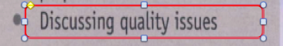
Unit2: Section1: Describing specific materials
Unit2: Section2: Categorizing materials
Unit3: Section 2: Explaining and assessing manufacturing techniques
Unit3: Section 3: Explaining jointing and fixing technique
Unit9: Section 1: Explaining tests and experiments
Unit9: Section 4: Discussing causes and effects
Unit10: Section1: Discussing performance and suitability
Unit10: Section 2: Describing physical forces.

Slide 4
Review Material and properties/ Qualities
Ttransparent
steel
heavy
durable
light
Elastic
heat-resistant
copper
plastic
shock-resistant,
glass
gold
waterproof
Silver
flame-retardant
durable,
Rubber
aluminium
brittle
Scratch-resistant
Titanium
Wood
Stretchy
water-resistant
fire-resistant

Slide 5
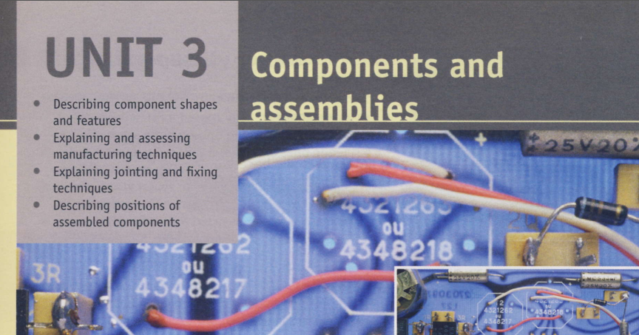

Slide 6
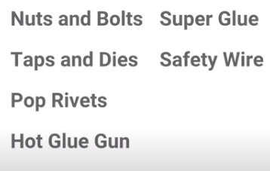
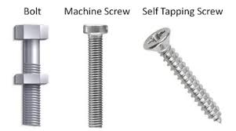
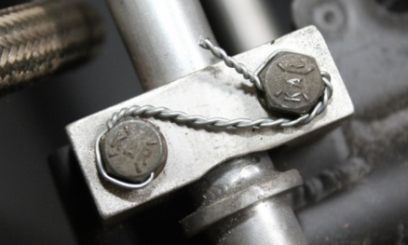
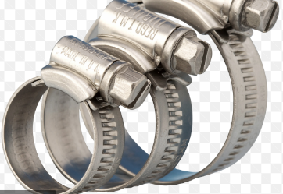
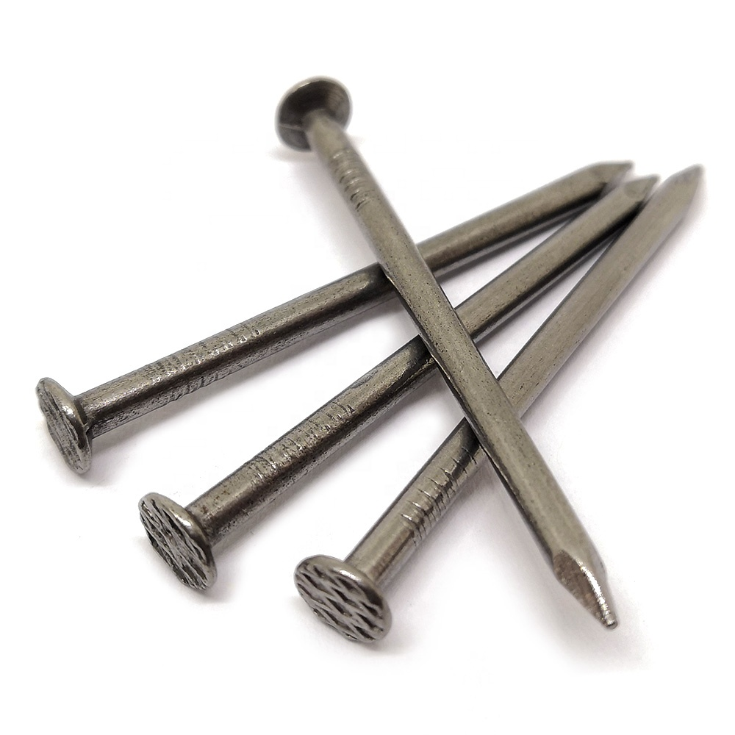
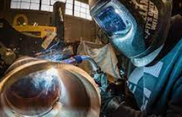
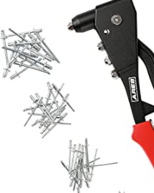
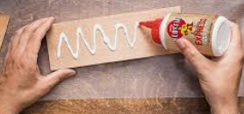
2
3
4
1
5
Nut
6
nails
Jubilee Clip
7
Welding
8
9
Rivet Gun
Wood Glue/ Adhesive
10
Notes:
Hot glue gun
Super glue

Slide 7

Notes:
You will find the following vocabulary useful in this section. bolt, screw, rivet, clip, weld, adhesive, bond, glue, join, connect, fix Students complete the task in pairs. For ideas, they could look around the room and identify different joints used in the furniture, fittings and fixtures.

Slide 8
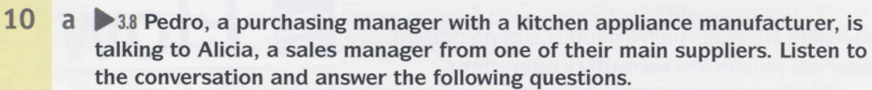
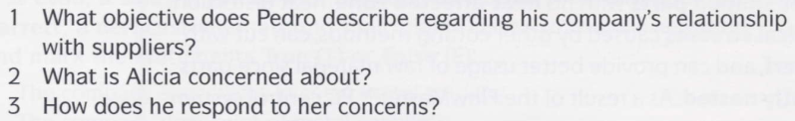


Slide 9


Slide 10
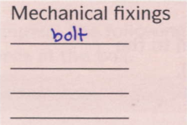
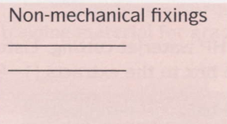
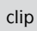
Notes:
1. Mechanical fixings: screw, rivet, clip 2 Non-mechanical fixings: weld, adhesive

Slide 11
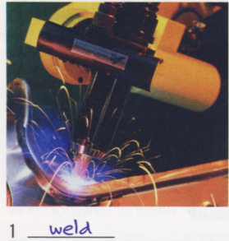
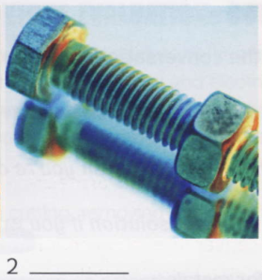
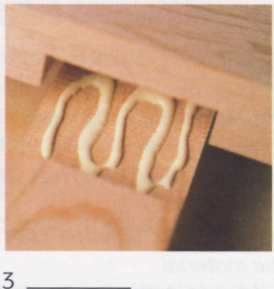
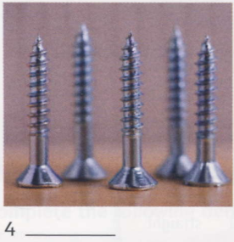
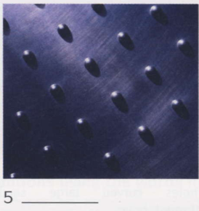
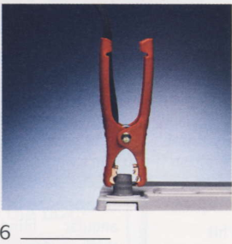

Slide 12
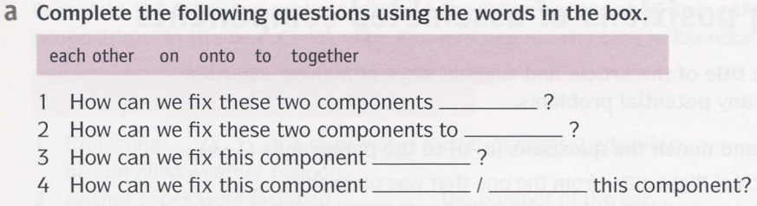
Together
each other
on
To / onto
Notes:
Answers 1 together 3 on 2 each other 4 to/onto

Slide 13
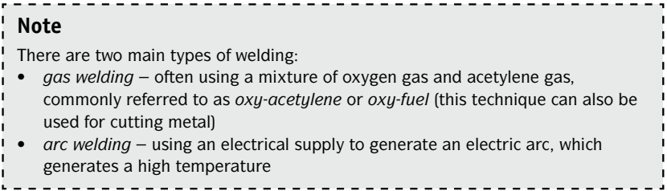
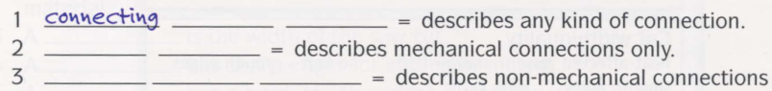
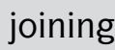
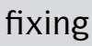
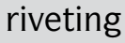
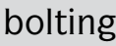
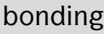
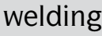
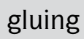

Slide 14
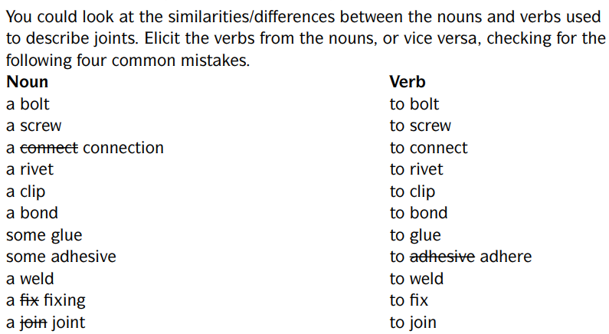
…1….…….
…….…2….
…….…3….
…….4…….
…….5…….
…….…6….
…….…7….
…….…8….

Slide 15
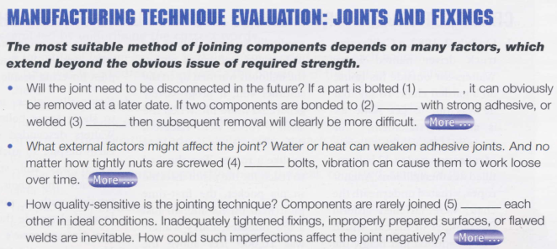

Slide 16
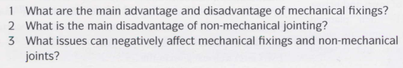

Slide 20
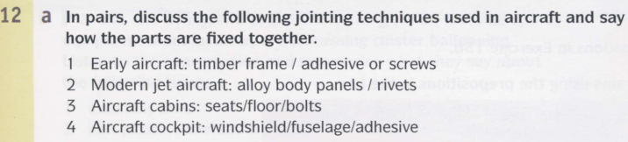

Slide 24
Notes:
Fuselage the body of the air craft or plain

